Slide 1
CAP7005E: Handling of Scientific and Technical Information Prior Reading Week 1: Information Needs, Literature Review, and Library Website
Fall 2023
Notes:
Hello everybody!
In preparation for the first session, please read this presentation, answer the questions, and do the exercises.

Slide 2
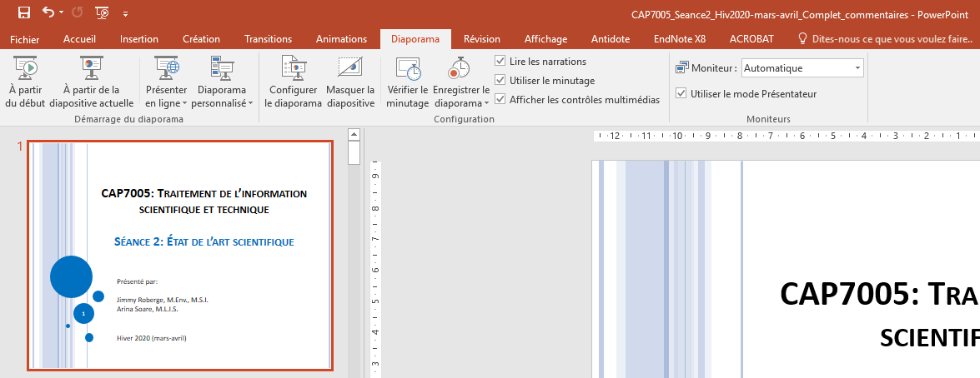
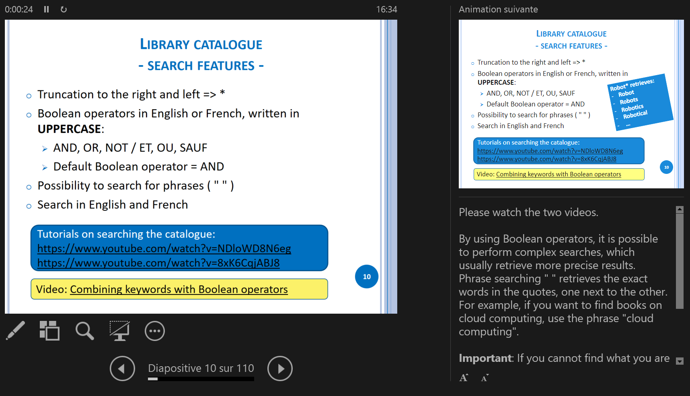
For an optimal experience: Presenter View
Press Alt+F5 to view the slideshow in presenter view (on some laptops, use Alt+Fn+F5).
The Presenter View allows you to follow the presentation with functional links and to view comments at the same time.

Slide 3

Prior Reading Week 1: Objectives
To learn about the main types of scientific documents.
To reflect on your information needs.
To know what a literature review is.
To understand the organization of the Library website and to learn how to find specific documents.
3

Slide 4
Your Information Needs

Slide 5
Main types of scientific documents
Journal article
Regular article
Letter
Brief report
Comment / reply
Editorial
Review article
Grey literature: information produced on all levels of government, academia, business and industry in electronic and print formats not controlled by commercial publishing: technical papers, patents, reports, etc. (https://youtu.be/8yUnBcFAn7I)
Conference proceedings
Book
Book chapter
Thesis
Standard
Patent
Technical note
…
More information:
Montgomery, S.L. (2003). The Chicago guide to communicating science. University of Chicago Press.
GEN T 10.5 M66 2003
Hofmann, A. (2020). Scientific writing and communication: Papers, proposals, and presentations. (4th ed.). Oxford University Press.
GEN Q 223 H63 2020
5
Notes:
There are several types of scientific documents and surely you have already consulted some of them. However, do you really know the differences between the different types of journal articles?
Journal articles: The most common type of article, also called research articles/papers. They are published in academic journals and present a specific finding, often including the sections Abstract – Introduction – Methodology – Results – Discussion – Conclusion.
Letter: Brief research article, usually less than 5 or 6 pages, that presents significant new findings. Sometimes referred to as a Letter to the Editor.
Brief report: A short article that generally announces a discovery before the full article is published.
Comment / reply: Criticism or opinion on an article published in the journal. This way, readers and authors can discuss.
Editorial: A short opinion piece, usually addressing the topic of the journal issue.
Review article = literature review: Provides a state of the art on a topic from selected publications. Usually contains a long reference list.
Technical note: “A short article giving a brief description of a specific development, technique or procedure, or a modification of an existing technique, procedure or device. Technical notes are variously referred to as technical innovations or technical developments. The main criteria for publication will be the novelty of concepts involved, the validity of the technique and its potential.” (Source: https://www.ncbi.nlm.nih.gov/pubmed/20358146)
Some journals specialize in publishing only one type of article, whereas others accept several types of articles.
This workshop will present several resources for finding the main types of scientific documents listed here.

Slide 6
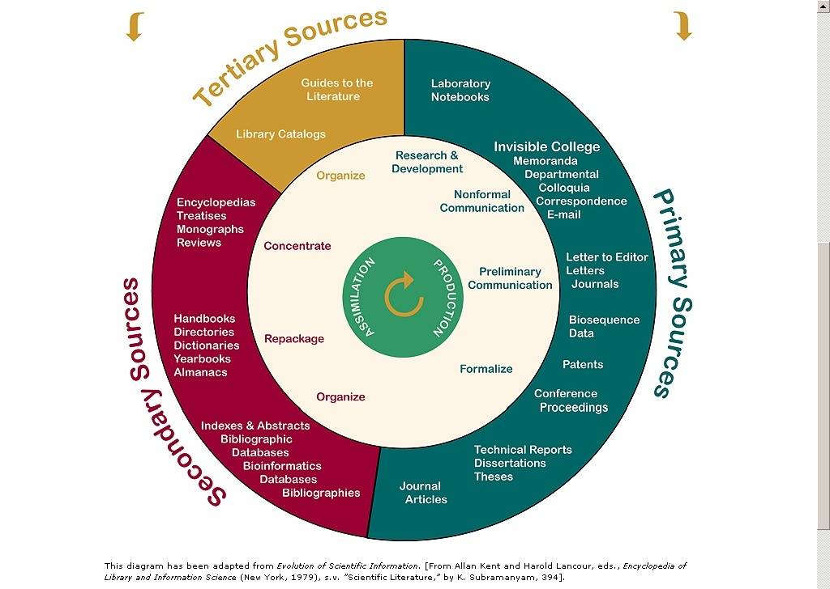
The Cycle of Scientific Information
Originated from "Evolution of Scientific Information." From Allan Kent and Harold Lancour, eds., Encyclopedia of Library and Information Science (New York, 1979), s.v. "Scientific Literature," by K. Subramanyam, 394, this diagram was adapted by Timken Science Library, College of Wooster.
Notes:
The cycle of scientific information shows how scientific information is created and assimilated.
Information is created through primary sources, which are original documents written by the witnesses to an event (experiment, etc.).
For example, a researcher produces laboratory notebooks, based on which he can share his findings with colleagues (by e-mail), and then publish a journal article, which will be included in a bibliographic database. If they are important, the findings in this article could be included in an encyclopaedia, which could later be mentioned in a guide to the literature.
A guide to the literature lists important works on a particular subject, compiling primary and secondary sources. Since new primary sources are continuously published, the guides can quickly become outdated. More and more guides are in electronic format, so they can be frequently updated. The Library has developed several guides by fields of engineering: https://libguides.biblio.polymtl.ca/resources_by_subject.
We recommend that you start information retrieval by referring to tertiary sources, then secondary sources, and finally primary sources, in this order. That is, you should begin by becoming familiar with a subject in general by consulting tertiary and secondary sources, and then be able to consult very specific primary sources on precise aspects of your research. Once you have done this, you will in turn be able to create primary sources (such as your thesis or dissertation), which will be included at least in our institutional repository, PolyPublie (a secondary source).

Slide 7
Something to think about…
1. What are your information needs in the context of your studies/research project?
On what topics will you seek information?
2. What is your approach for finding the appropriate information? Where will you search (or where have you already searched)?
Try to be as precise as possible. For example, don’t answer ‘Database’, but rather the name of the database you used.
Answer the questions on socrative.com → Student Login → Room ARINAS.
Your answers will contribute to the discussion in class
Notes:
Q1 could also be: For what topic will you be looking for information for your Master's or PhD project? What types of information will you need?
Q2: What sources of information do you already use? How do you usually search?
Take a few minutes to think about the questions and then enter your answers on Socrative.
Your answers will contribute to the discussion in class.

Slide 8
The Literature Review

Slide 9
Literature review
“A comprehensive survey of the works published in a particular field of study or line of research, usually over a specific period of time, in the form of an in-depth, critical bibliographic essay or annotated list in which attention is drawn to the most significant works.” (ODLIS)
Some Terms Used for Searching Literature Reviews:
Review;
State of the art;
Advances in...;
Progress in...;
Yearbook of...;
Outlook;
Synthesis;
Critical survey;
Comprehensive survey;
Current state of knowledge;
Current topics in…;
État de l'art;
Recension des écrits;
Revue de littérature.
Notes:
Although the definition states “a comprehensive survey of the works ...", sometimes it can be difficult to find everything that was written on a topic. Still, in your literature review you should show that you tried to be as comprehensive as possible. Keep this in mind when searching for articles by using the classical search method presented later in this workshop: in order to be exhaustive, you should search quite broadly, and therefore find information that is not necessarily relevant to your topic.
This workshop is given by librarians, who are experts in finding literature, and will show you how to be comprehensive in your search for information. You will see other methods to diversify your ways of searching for information, and this should help you to thoroughly search for materials related to your project.
The literature review should be one of the first steps in a research project. In addition, it is an ongoing step. You cannot say, "I will do my literature review in the first 6 months of my PhD and then finish with it”. At the beginning, you will search more intensively to find out everything that had been done so far, but afterwards you should keep following what is happening in your field. This workshop will show you how to do that first thorough literature search, along with convenient means to keep up to date.

Slide 10
Usefulness of the literature review
Reasons for Reviewing the Literature | Objectives of the Literature Review
Developments in the field | Inform students of developments
Knowledge of information resources and research methods | Establish your credibility
Identify gaps in the literature = research questions | Discuss relevance and scope of your questions
Evaluate methodologies | Context of your methodological approach
Develop your own methodological approach | Discuss relevance and applicability of your approach
O'Leary, Z. (2004). Working with literature. In The essential guide to doing
research (p. 79). SAGE. https://polymtl.on.worldcat.org/oclc/61494250
Notes:
The literature review also allows you to identify important researchers in your field, as well as collaborative networks.

Slide 11
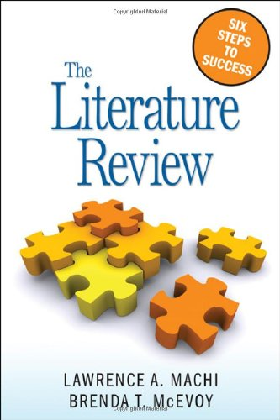
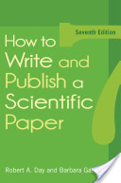
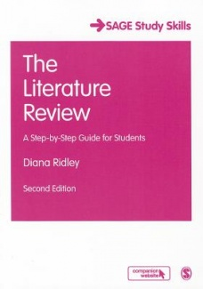
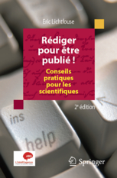
Writing a literature review
Consult our Literature Review guide, and especially the tabs Conduct a Literature Review and Writing Tools, for a checklist of criteria and for recommended books on the subject.
Notes:
Writing a literature review can be difficult. In the Library collection, we have several methodology books addressing this topic, many of them in electronic format. Use the guide Literature Review to find and access them.
CAP7005E will not cover the actual writing process, but you will learn how to find the documents you need for your literature review.

Slide 12
Services provided by
the Library

Slide 13
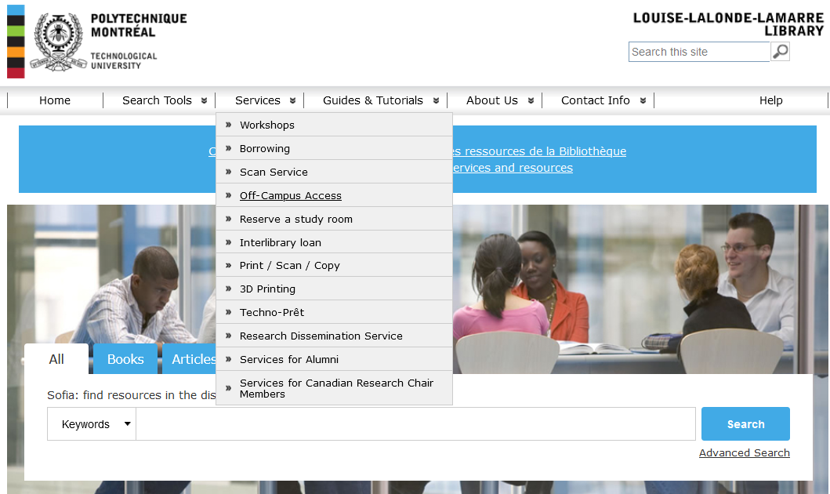
Library website – Services
www.polymtl.ca/biblio/en
Notes:
The Library offers several services which are well detailed on the website.
One of the most important at the moment is the installation of the proxy to access our resources from outside Polytechnique.

Slide 14
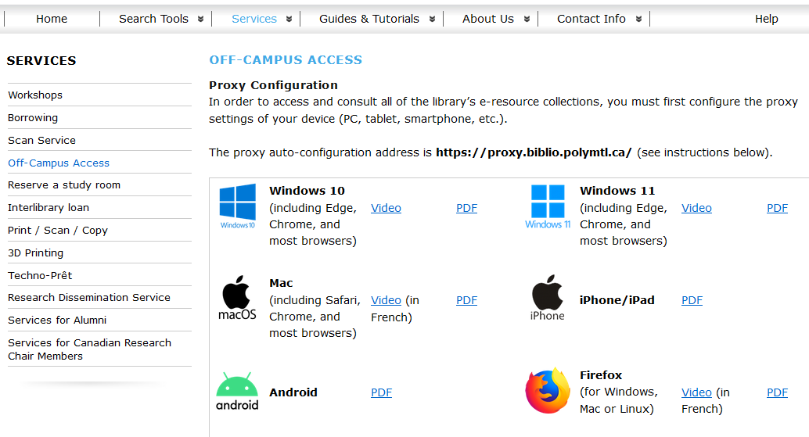
Library website – off-campus access
https://www.polymtl.ca/biblio/en/network_access
Notes:
Please configure your proxy now!
The steps to install it according to your browser and type of electronic device are explained in the videos and PDFs on this page.

Slide 15
Some other library services
Study areas
Individual and collaborative workspaces, as well as computer stations (room L-7607 and 7th floor) do not require a reservation.
To access a group study room, a reservation is required.
Borrow laptops with Antidote and EndNote installed
Borrow board games
Scan and print
Interlibrary loan (for books and articles that we do not have)
Borrow documents from the Library and from other universities in Quebec: with your Poly ID card
Any question? biblio@polymtl.ca or 514-340-4666
Notes:
Antidote can help you write your texts by minimizing language errors. This software is available in French and in English on the laptops lent by the Library.
Do not hesitate to contact us!

Slide 16
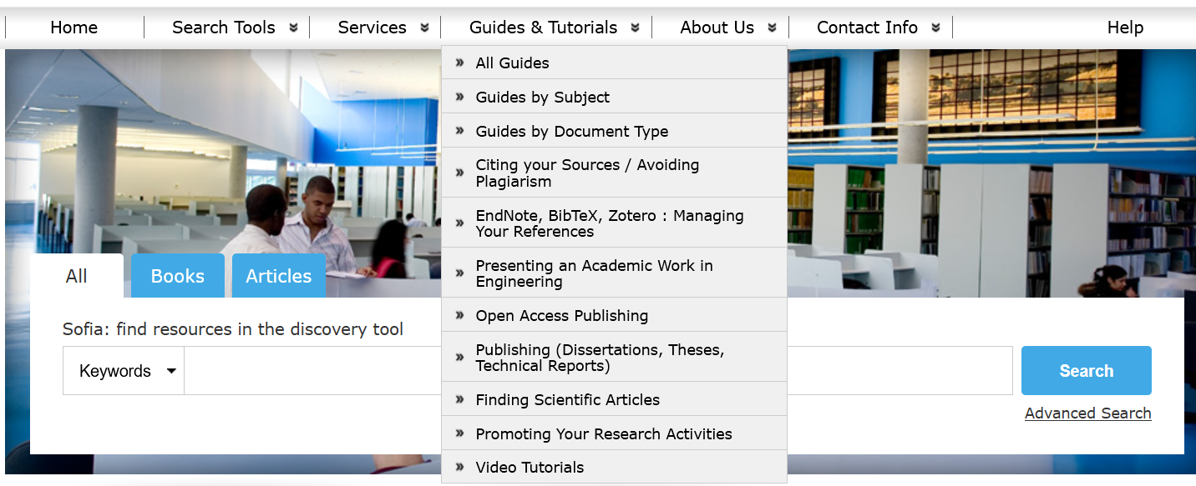
Library website – Guides & Tutorials
Notes:
The guides developed by the Library cover all fields of engineering at Polytechnique, in addition to more general topics such as citation, plagiarism, open access, and publishing.
Click on All guides to display an alphabetical list of guides.
Click on Guides by Subject to see all the guides grouped according to various subjects, including different fields of engineering.

Slide 17
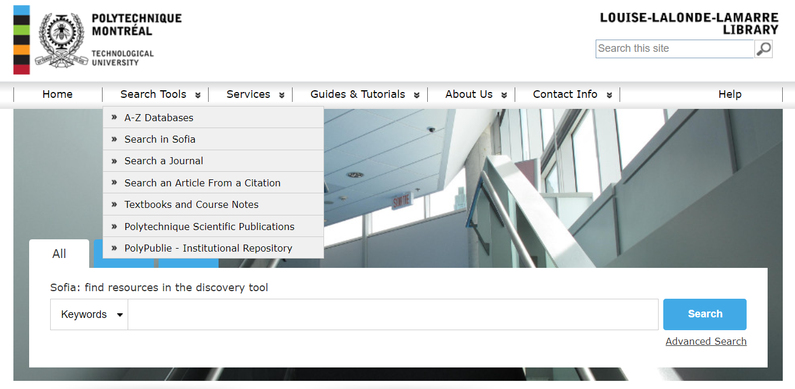
Library website – Search tools
Notes:
The Library website includes several document search tools.
A-Z Databases lists alphabetically the recommended databases, which can be sorted by subject and by document type.
Search in Sofia allows searching the Library collection (or collections of other universities in Quebec), which mainly includes books (another annotated presentation to introduce and explain the search in the Sofia discovery tool is available on Moodle).
Search a journal allows searching for a journal using keywords and find out if the Library owns it or subscribes to it.
Search an Article from a Citation is very useful to search for references written according to citation styles in which the title of articles is not included, such as the RCS (Royal Society of Chemistry) citation style**. Enter here the ISSN identifier, DOI, journal, issue, number and/or start page to find out where the full text is available (in which database).
**Example of a reference in RCS:
T. J. Hebden, R. R. Schrock, M. K. Takase and P. Müller, Chem. Commun., 2012, 48, 1851–1853.

Slide 18
Exercise
On the Library website:
Identify a dictionary or an encyclopedia recommended in your field of engineering.
Identify a bibliographic database recommended in your field of engineering, which includes journal articles and conference papers.
Identify a patents database that is restricted to the members of the Polytechnique community.
Notes:
Take the time to explore the Library website, so you will be able to find the resources you need.
Many search methods presented in this workshop are performed starting from the Library website. It is therefore important to explore it and to understand its organization.
After you do this exercise on your own (or if you could not do it), check out the next few slides for the answers.

Slide 19
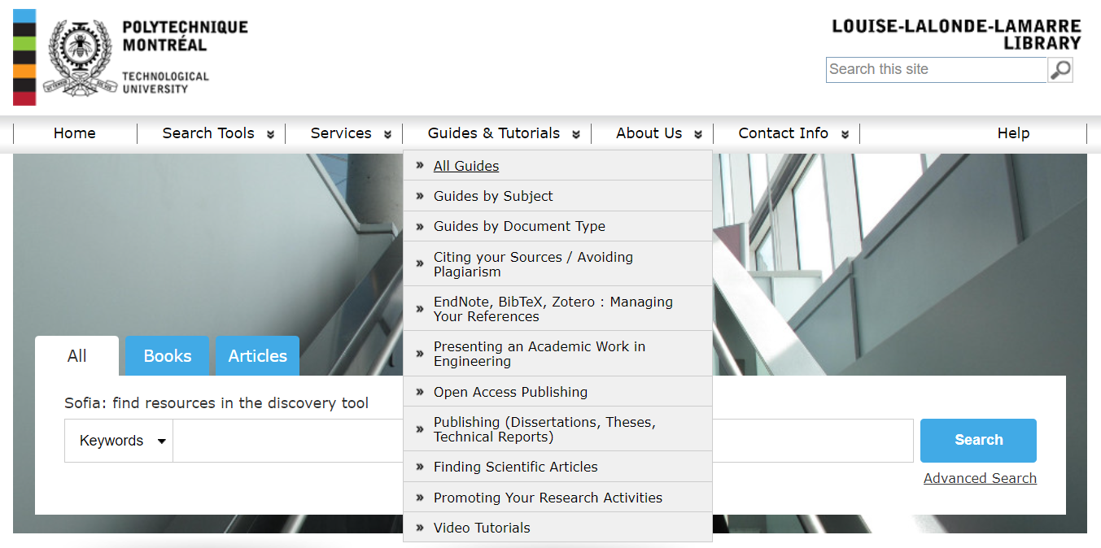
Exercise 3 a) Find a bibliographic database recommended in your field – Answer…

Slide 20
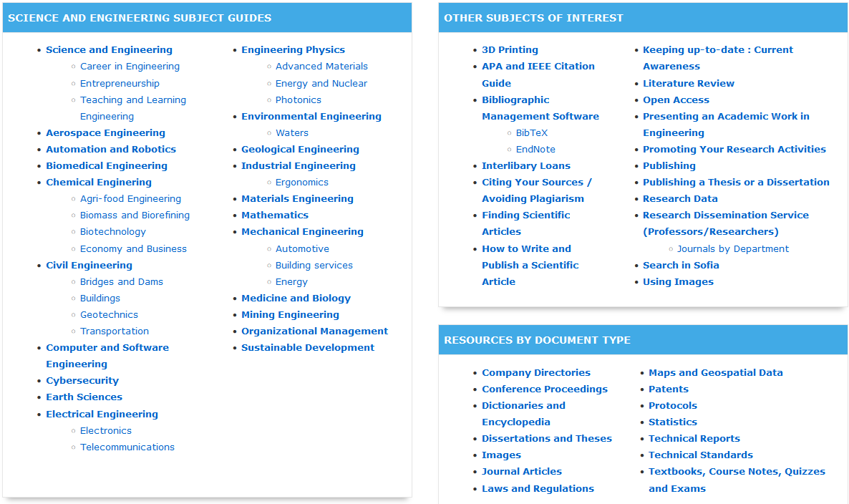
Exercise 3 a) Find a bibliographic database recommended in your field – Answer…
Find the disciplinary guide(s) appropriate for you
Notes:
More than one guide may be useful to find information on your research topic. Explore all guides that seem relevant to you.

Slide 21
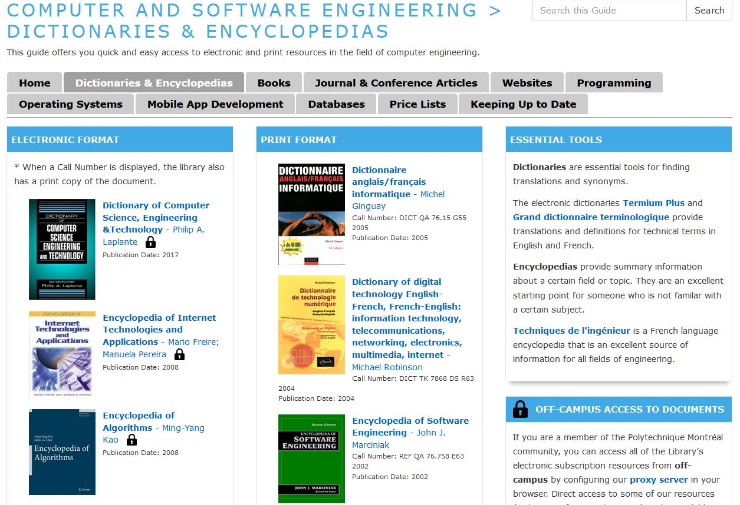
Exercise 3 a) - answer
Click Dictionaries & Encyclopedias
Suggested resources may be available in electronic and/or print format.
Notes:
Some documents are presented in the guides according to their print or electronic format.
There is a lock symbol next to most titles in electronic format, which shows that these documents are made available to the Polytechnique community through Library subscriptions. To access them from off-campus, install the Library proxy.

Slide 22
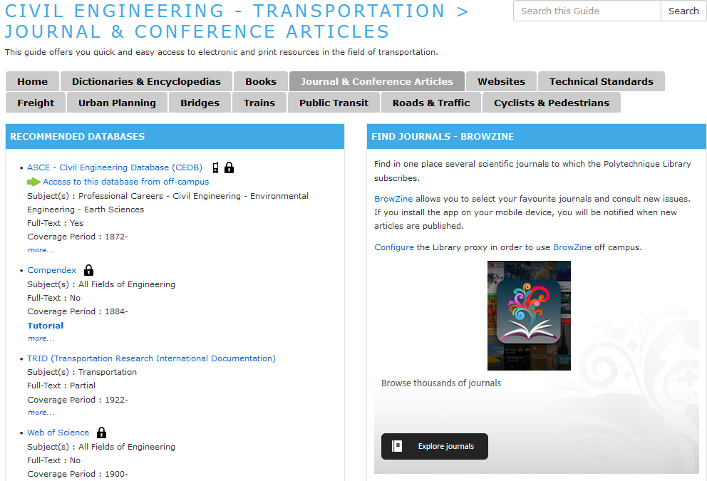
Exercise 3 b) – Find a bibliographic database recommended in your field – Answer
In the disciplinary guide, click Journal & Conference Articles
Recommended and optional resources are listed in each disciplinary guide.
Notes:
Journal articles and conferences papers can often be found in the same databases. If you are looking only for one or the other, you will find options to select them once you access the database.
Note that Compendex and Web of Science databases are recommended for all fields of engineering. We will explore them in more detail later in this workshop.

Slide 23
Exercise 3 c) – patents databases - Answer
Notes:
When looking for patents, we are looking for a specific type of document rather than for resources in a particular field of engineering. You can also consult the other guides under Guides by Document Type for types of documents useful in engineering.

Slide 24
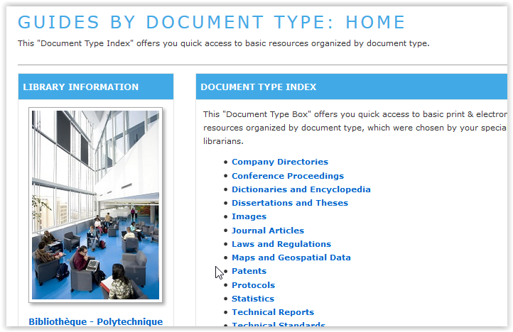
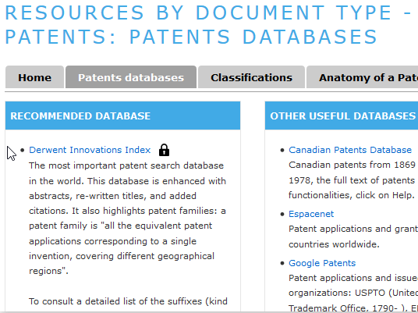
Exercise 3 c) – patents databases - Answer
Notes:
The restricted access is indicated by the lock icon, so Derwent Innovations Index is available to the Polytechnique community via Library subscription. The other patents databases in this guide are free resources accessible to all.

Slide 25
in conclusion
We encourage you to explore the Library website to discover the wide range of resources available to you.

Slide 26
To reach us
Library reference desk:
In person, at the counter
By email: biblio@polymtl.ca
By online chat: http://libguides.biblio.polymtl.ca/faq
You can also follow us on:
www.facebook.com/bibliopolymtl
www.Twitter.com/bibliopolymtl
https://www.instagram.com/bibliopolymtl
Notes:
Do not forget that the Reference Service can help you with general questions.
For questions directly related to this workshop or for further research assistance, contact the librarian in charge of your group.
Our Facebook and Twitter accounts can keep you informed on the latest interesting engineering and science news.

